Slide 1
Cornerstone Forum
November 2023
Notes:
STEPHANIE

Slide 2
Before We Begin…
We are recording. Attendees have been placed on mute.
We will address questions throughout the meeting.
Submit questions for the presenters through the Q&A function.
Meeting materials will be available online for download.
Notes:
STEPHANIE

Slide 3
On the Agenda
Welcome
Cornerstone Roadmap
Procurement Projects Lease Administration
Travel and Expense
J. Michael Gower
Executive Vice President-Chief Financial Officer and Treasurer
Notes:
MIKE

Slide 4
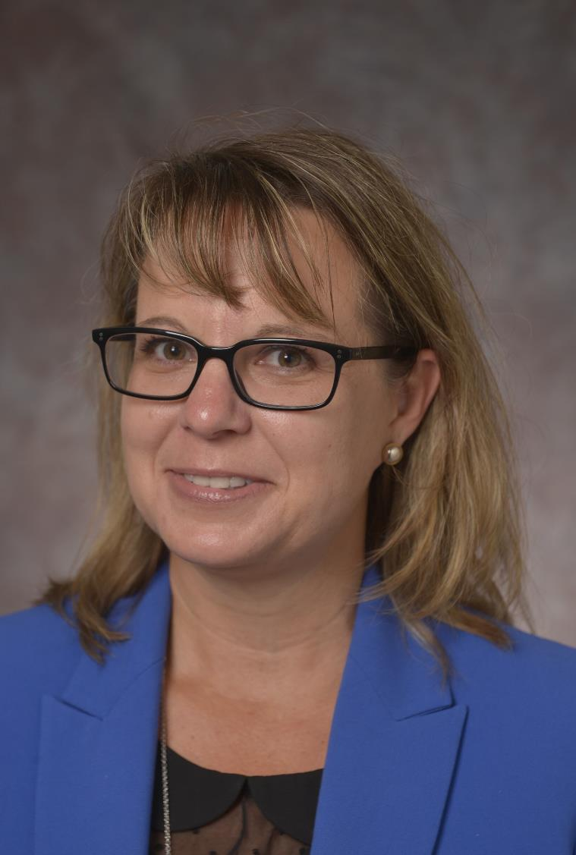
On the Agenda
Student Experience Improvement Initiative
Ellen Law
Associate Vice President, Office of Information Technology Enterprise Application Services
Notes:
MIKE

Slide 5
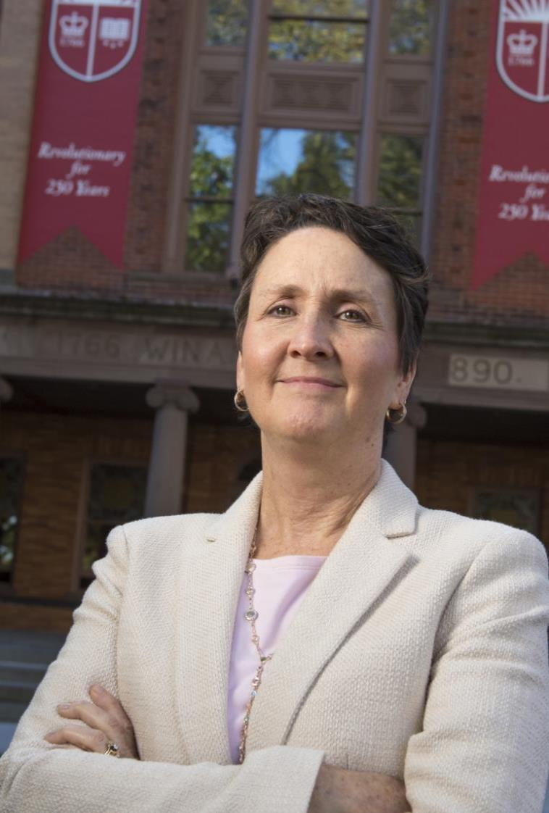
On the Agenda
Common App
Michele Norin
Senior Vice President, Chief Information Officer
Notes:
MIKE

Slide 6
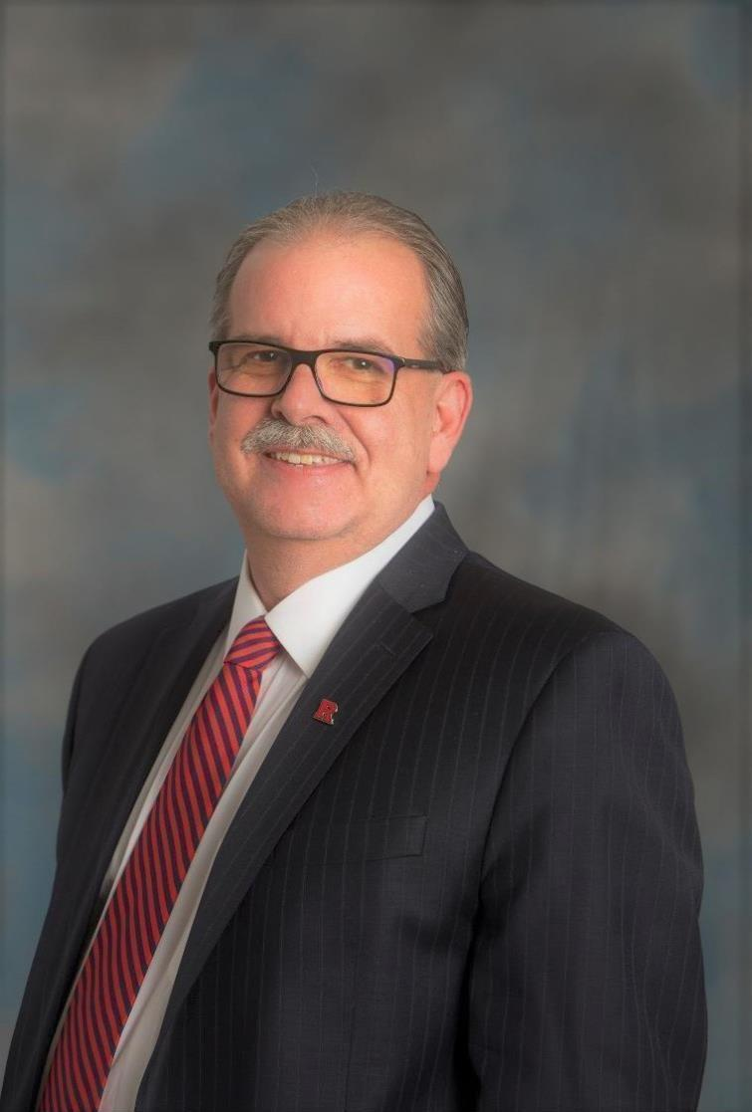
On the Agenda
Scarlet Journey
HR/Payroll Transformation
John V. Fahey
Vice President for UFA Operations and
Project Executive
Notes:
MIKE

Slide 7
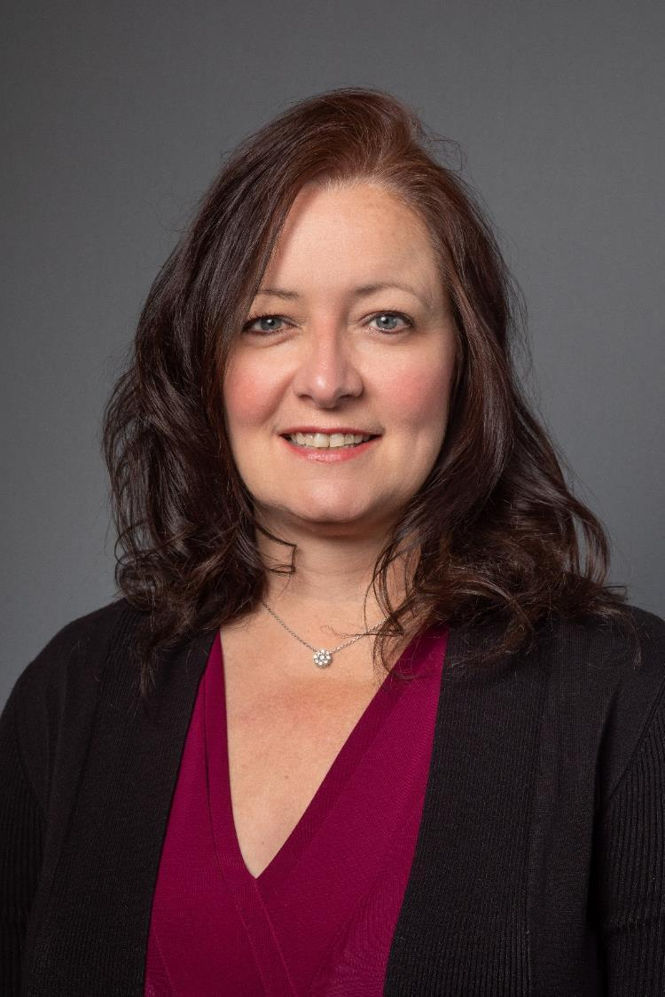
On the Agenda
Scarlet Journey Foundation and Alumni Relations
Candy Knaus-Huber
Managing Director, Systems and Technology Rutgers University Foundation
Notes:
MIKE

Slide 8
Roadmap Update Current Initiatives
Scarlet Journey (Salesforce CRM)
Student Experience Improvement Initiative (SEII)
HR/Payroll Transformation
Athletics
Oracle Student Financial Planning
Stabilization
Process
Review and
Re-engineering
Foundation and Alumni Relations
Student
Process
Alignment
Oracle Human Capital Management (HCM) Cloud
Enrollment
Management
Phase 2
Oracle Student
Management
Cloud
Common
App
Chart of Accounts
Phase 2
Procurement
SAP Concur Travel Expense Management
Lease Administration
Notes:
MICHELE

Slide 9
Procurement Projects
Recently Completed
Project | Summary | Completion date
Lease Administration | Phase 2 implementation Government Accounting Standards Board 96 compliance Enhanced data and reporting | July 2023
In Progress
Project | Summary | Anticipated Launch
Travel and Expense Management System | Enhanced travel and expense management in a single SAP Concur system | July 2024
Notes:
JOHN

Slide 10
Student Experience Improvement Initiative (SEII)
Background
The Student Experience Improvement Initiative (SEII) advances the University’s dedication to providing seamless, integrated, consistent, effective, and responsive services that meet Rutgers students’ needs. The project focuses on improving student service levels, business processes, compliance risks, technology, and supporting organizational structures into a single universitywide student information system within the Oracle Cloud enterprise.
Accomplishments | Current Status | Next Steps
Launched Student Financial Planning (SFP) Created new Student Financial Planning reporting dashboard | Continue to stabilize student financial planning system Enhance reporting and analytics capabilities | Student Continuum project Kick off implementation of Student Management Cloud
Notes:
ELLEN

Slide 11
Common App
Background
Common App is a hosted, online college application which allows students to apply to more than 1,000 member colleges and universities, streamlining the data entry process for applicants.
Accomplishments | Current Status | Next Steps
Launched for first-year undergraduate applications on August 1, 2023 Successfully loaded student information, including prospects and submitted applications, successfully loaded into CRM (Salesforce) Provided control center access and training to all Chancellor-led units for advanced reporting capabilities and detailed access to student application data Enabled Marketing Cloud to send to Common App users for CommunityID activation | Enhance reporting and analytics Track and validate application payments from Transact, the Common App payment processing vendor | Integrate official high school transcripts Add transfer student functionality Gather requirements for Direct Admit program (in progress)
Notes:
ELLEN

Slide 12
Salesforce/Common App Applications Submitted
Total AY2024/2025 Applications*
 | Undergrad | Grad | Total
Camden | 12,629 | 1,538 | 14,167
New Brunswick | 73,062 | 10,170 | 83,232
Newark | 18,785 | 1,013 | 19,798
RBHS | 86 | 1,814 | 1,900
Total | 104,562 | 14,535 | 119,097
Positive trends continue since the launch of Salesforce and Common App:
Received a total of 104,562 Under Grad applications for AY2024/2025
92,213 from Common App
12,349 from Salesforce
Loaded contact information into Salesforce for over 48,000 prospective applicants from Common App
Number of applications by campus above are not “unique” applications and includes multiple school applications for single applicant
*Reflects total number of applications submitted as of 11/06/2023

Slide 13
Scarlet Journey (CRM)
Background
Scarlet Journey is a multi-year, universitywide Constituent Relationship Management (CRM) implementation built using Salesforce. The program will enable Rutgers to create exceptional experiences and impactful relationships with its constituents through a connected understanding of needs, improved interactions, and tailored services.
Accomplishments | Current Status | Next Steps
Configured CRM application to closely align with Common App, streamlining the current application process Integrated School of Health Professions (SHP) undergraduate transfer students into current CRM application and process. All undergraduate schools available on Salesforce and Common App Updated contact records updated with event registration data captured from Fonteva Worked with Chancellor-led units’ enrollment teams on prioritization of system enhancements | Add residency checklist Update admit letters using Conga Implement automations (visa status, EOF checklist, alumni application fee waivers, etc.) Integrate School of Dental Medicine. Requirements gathering ongoing with anticipated spring 2024 launch. Implement Marketing Cloud for Rutgers Business School and RU Global Update AY24-25 applicants’ fast track criteria Updating school-to-school transfer applications to include School of Health Professions | Integration with Robert Wood Johnson Medical School and New Jersey Medical School, and Rutgers Law School

Slide 14
Rutgers Foundation/Scarlet Journey
Transforming systems to modernize and advance operations at the Rutgers Foundation allows work at scale.
2022/2023 Progress to Date
Three workstreams (in order of launch):
Salesforce Marketing Cloud
Salesforce Commerce Cloud
CRM – Affinaquest (Salesforce Sales Cloud)

Slide 15
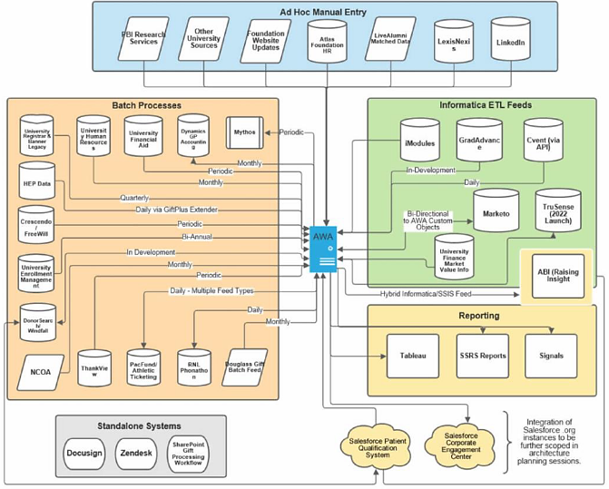
Current State

Slide 16
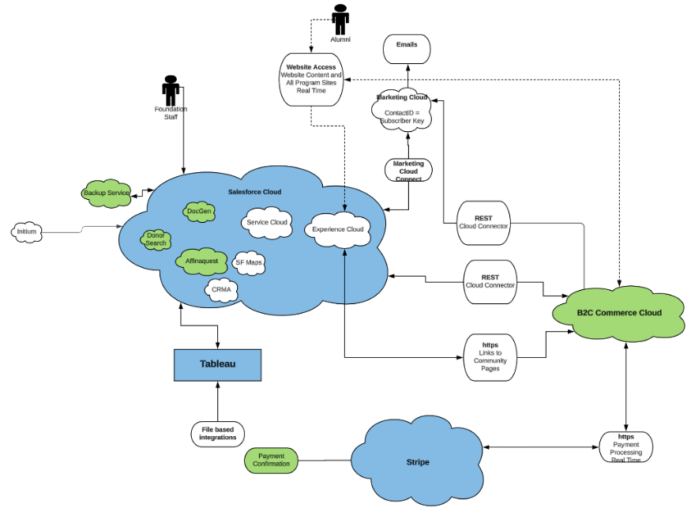
Future State with Salesforce

Slide 17
Rutgers Foundation/Scarlet Journey
Foundation and Alumni Relations
Marketing Cloud
Accomplishments | Current Status | Next Steps
Phase 1 – central communications, launched September 2022 Phase 2 – “Email Concierge” emails from clubs, schools, and units launched in September 2023 Rutgers is the first college/university in the nation to develop a tool specifically for this purpose | Status quo. Work on enhancements based on feedback from the user community Onboard additional schools, units, clubs Development of journeys, MobileConnect texting campaigns, policies and procedures | Email concierge enhancements phase to begin November 2023, focusing on enhancing and facilitating user experience Connect Marketing Cloud to CRM (Affinaquest) once CRM is fully implemented. Anticipate launch in late 2024

Slide 18
Access to Marketing Cloud Email Concierge
Marketing Cloud – Email Concierge
Schools or units that previously sent emails via the Foundation’s Marketo environment and want access to email concierge, visit rutgersfoundation.org/communications-intake-form to request access.

Slide 19
Rutgers Foundation/Scarlet Journey
Foundation and Alumni Relations
Commerce Cloud – Give.RutgersFoundation.Org
Accomplishments | Current Status | Next Steps
Phase 1 of Commerce Cloud was the replacement of primary giving site and launched mid-September 2023 Rutgers is the third college/university in the nation to move to Commerce Cloud for online giving New Rutgers Foundation website launched September 2023 Re-brand Foundation to rutgersfoundation.org | Phase 2 begins shortly and includes enhancements to the site and replacement of other giving sites | Complete Phase 2 with implementation partners and prepare to assume full responsibility for maintenance and further development of the site in-house

Slide 20
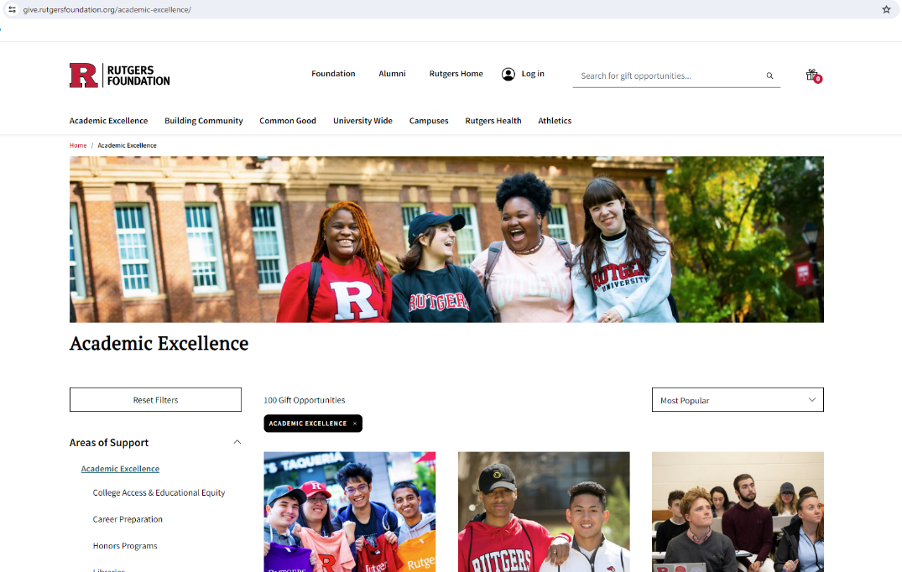
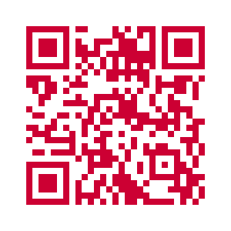
Commerce Cloud
Give.RutgersFoundation.org

Slide 21
Rutgers Foundation/Scarlet Journey
Foundation and Alumni Relations
CRM - Affinaquest (Sales Cloud)
Accomplishments | Current Status | Next Steps
Completed Phase 1 of Affinaquest Launched October 2023 Bio/Demo inquiry, summary giving information, prospect management related entry Data conversion from legacy CRM to Affinaquest Implemented interim integration of bio/demo data from legacy CRM to Affinaquest Implemented data move from Affinaquest into existing CRM to maintain reporting | Training and enhancements Phase 2 begins week of November 6 Bio/Demo maintenance, gift, engagement, reporting, analytics, document management Anticipate launch late 2024 At launch, current CRM will be disabled and fully live on Affinaquest for advancement operations | Data integrations with other Rutgers enterprise systems Connect Affinaquest to Marketing Cloud Connect to Commerce Cloud Events in FY25

Slide 22
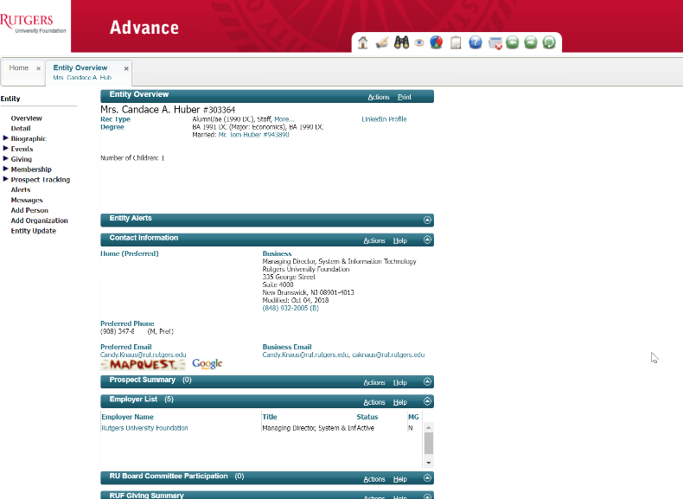
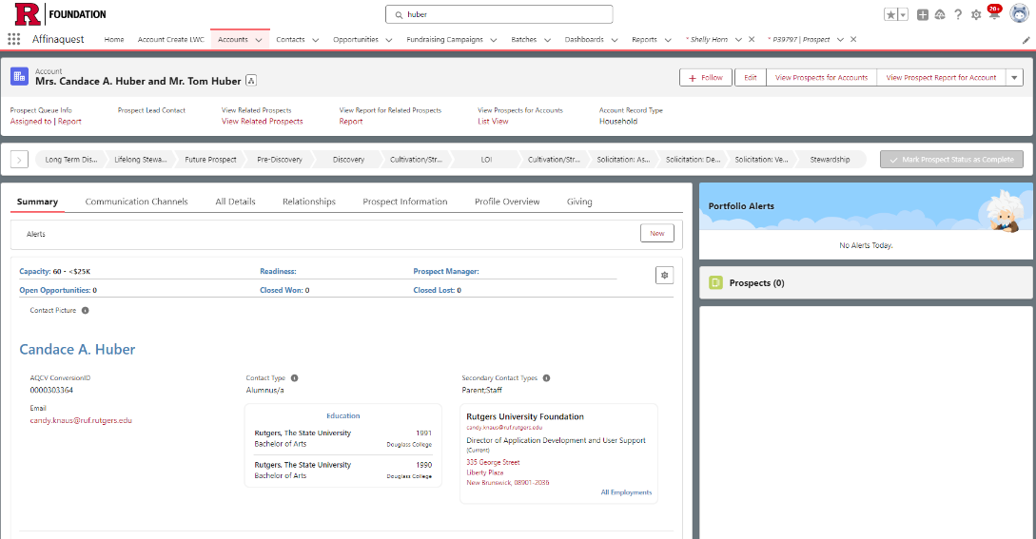
CRM – Affinaquest (Sales Cloud)
Legacy System
Affinaquest

Slide 23
Scarlet Journey (CRM)
Next Steps
Continue and complete phases 1 and 2 for Enrollment Management and Foundation Implement Phase 3 - Athletics Reassess research and corporate engagement Continue to evolve roadmap

Slide 24
HR/Payroll Transformation Initiative
Background
The HR/Payroll Transformation Initiative is designed to transform the university’s human resources and payroll processing services by standardizing practices, improving collaborations, and advancing a single identity and culture. This multi-year initiative will include the implementation of Oracle’s HCM cloud-based solution.
Accomplishments | Current Status | Next Steps
Completed system review for technical requirements gathering Kicked off functional business process review (BPR) – current state assessments Established Design Review Board Kicked off interactive design and prototype (IDP) sessions Established and kicked off Change Agent Network (CAN) | Continue BPR, IDP and CAN sessions Prepare for system configuration and build of phase one functionality | System configuration and initial testing Complete current state functional BPR Prepare for Future State functional BPR to kick off in March 2024

Slide 25
HR/Payroll Transformation Initiative
Process
People
Systems

Slide 26
Implementation Phases
Phase 1
Core HCM
Payroll
Strategic workforce planning
Benefits
Compensation
Absence management
Time & Labor
Phase 2
Recruiting
Performance management
Talent management
Succession planning
Career Development
Learning
Faculty lifecycle
Phase 3
Scope to be defined during discovery in phases 1 and 2
Critical Path Payroll
Go live – January 2025

Slide 27
BPR Sessions Update
Completed Systems BPR (technical requirements gathering)
Functional BPR – current state assessments:
July 2023 through March 2024: 39 weeks, ~150 meetings, ~500 hours, over 170 participants
Completed Talent Acquisition sessions, report, and feedback
All sessions completed Workforce Planning, Compensation, and Benefits
Reports and feedback are in progress
Time and Leave administration sessions are in progress
Absence, Payroll, and Cross Module scheduled for November 2023-March 2024

Slide 28
Transitions to Future State
Interactive Design Prototypes (IDPs) and Module Configuration Sprints
Design review board
Unification of configuration – One Rutgers
Larger population of data (loaded full table values, i.e. job codes and descriptions)
Unit testing of configuration and setup
Functional business process future state recommendations, redesign, and validation in March 2024
Systems integration testing in March 2024
User acceptance testing and parallel payroll testing in July 2024
Prepare for user training and continue execution of change management plan
Phase 1 launch January 2025

Slide 29
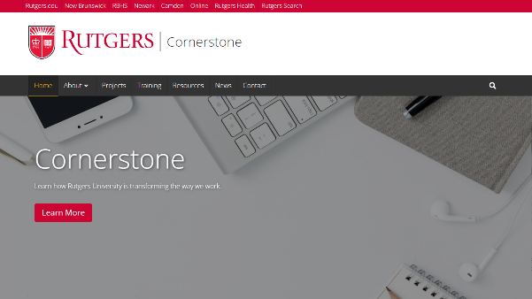
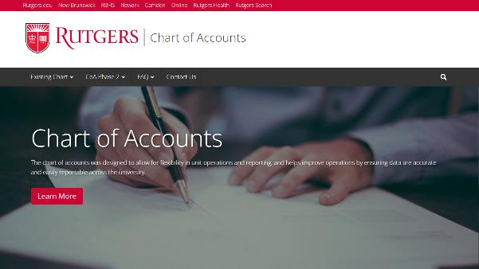
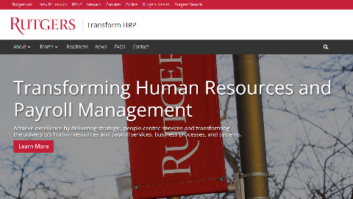
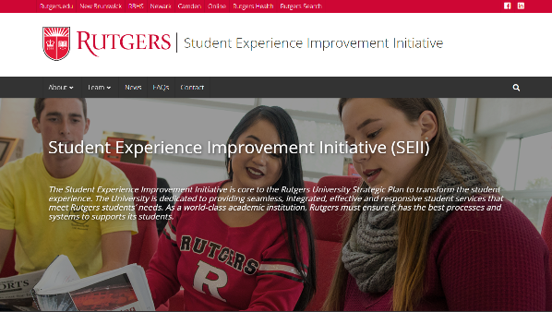
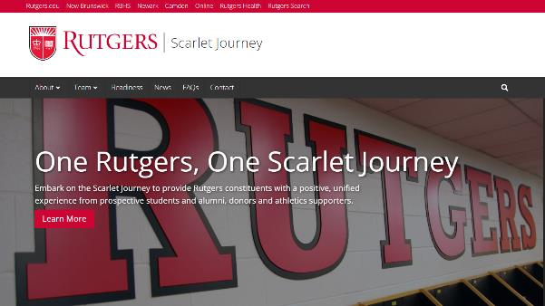
Project Management Office
For more information on the UFA Project Management Office, visit the UFA website!
Click images to open project websites.

Slide 30
What to expect going forward
Collaboration. Communication. Engagement.
Universitywide Cornerstone newsletter and forums
Regular website updates
Change agent networks
Notes:
MIKE

Slide 31
Questions

Slide 32
Cornerstone Forum
Thank you!
November 2023

